Slide 1



Slide 2
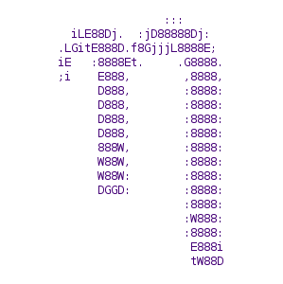

Other text editor
Nano Emacs

Slide 3

Who am I ?
I am a student here in 42.
I started coding during the November piscine of 2022. At first I struggled a lot with Vim, because I couldn’t remember how to exit or how to save a file.
After finishing the piscine I decide to stick with Vim, and I used it for all my project (Including minishell and miniRT).
My Vim configuration is available on github if you want to check it out…

Slide 4

Just the tip of the Iceberg
Vim is extremely powerful, and for this reason we won’t be able to cover all the aspect of this text editor.
There is a lot of things that I still don’t know.
We are going to cover only the basics today…

Slide 5
What we are not going to cover in this session
How to install Vim on Windows (there are tutorials online)
How to use Vim Macro (I still don’t know it to this day)
How to install plugins
Do your own research!

Slide 6
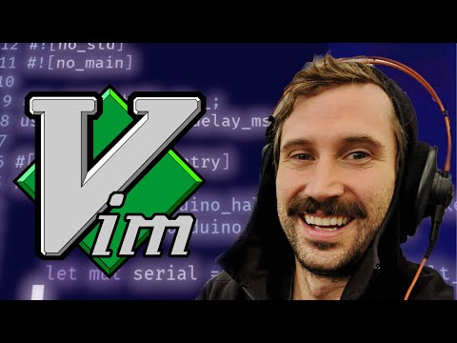
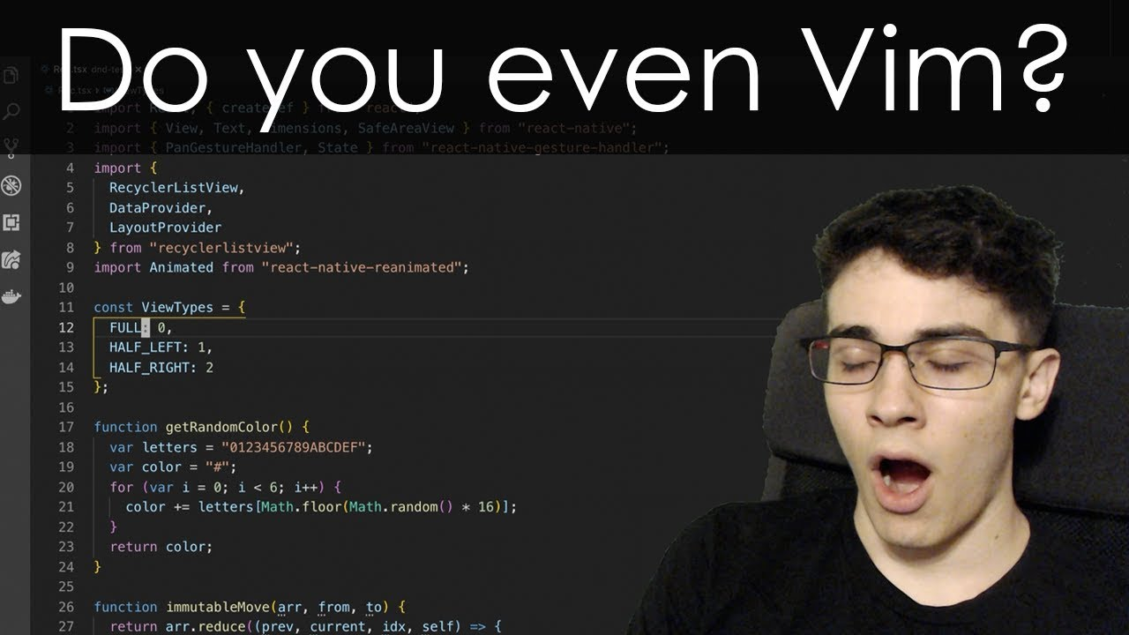
My inspiration for this presentation
Those two “Code-influencer” helped me a lot with their videos, I have linked their videos in my Github page as well

Slide 7


Slide 8
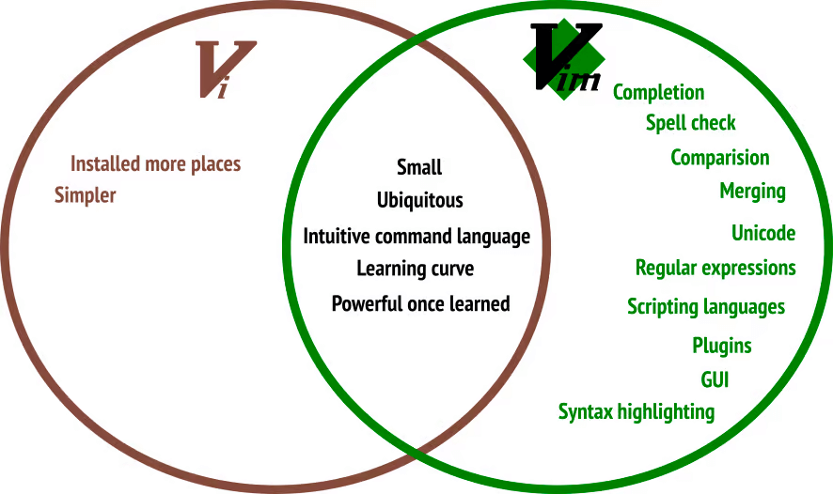

Slide 9
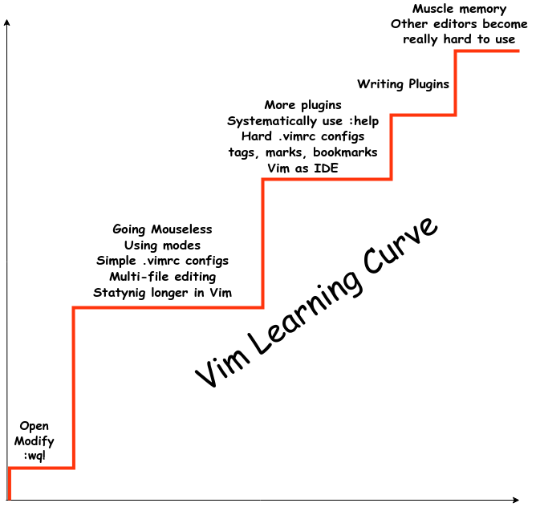
Learning curve
The learning curve for Vim is very steep compared to other text editor or IDE, but it is all a matter of Muscle memory and practice

Slide 10
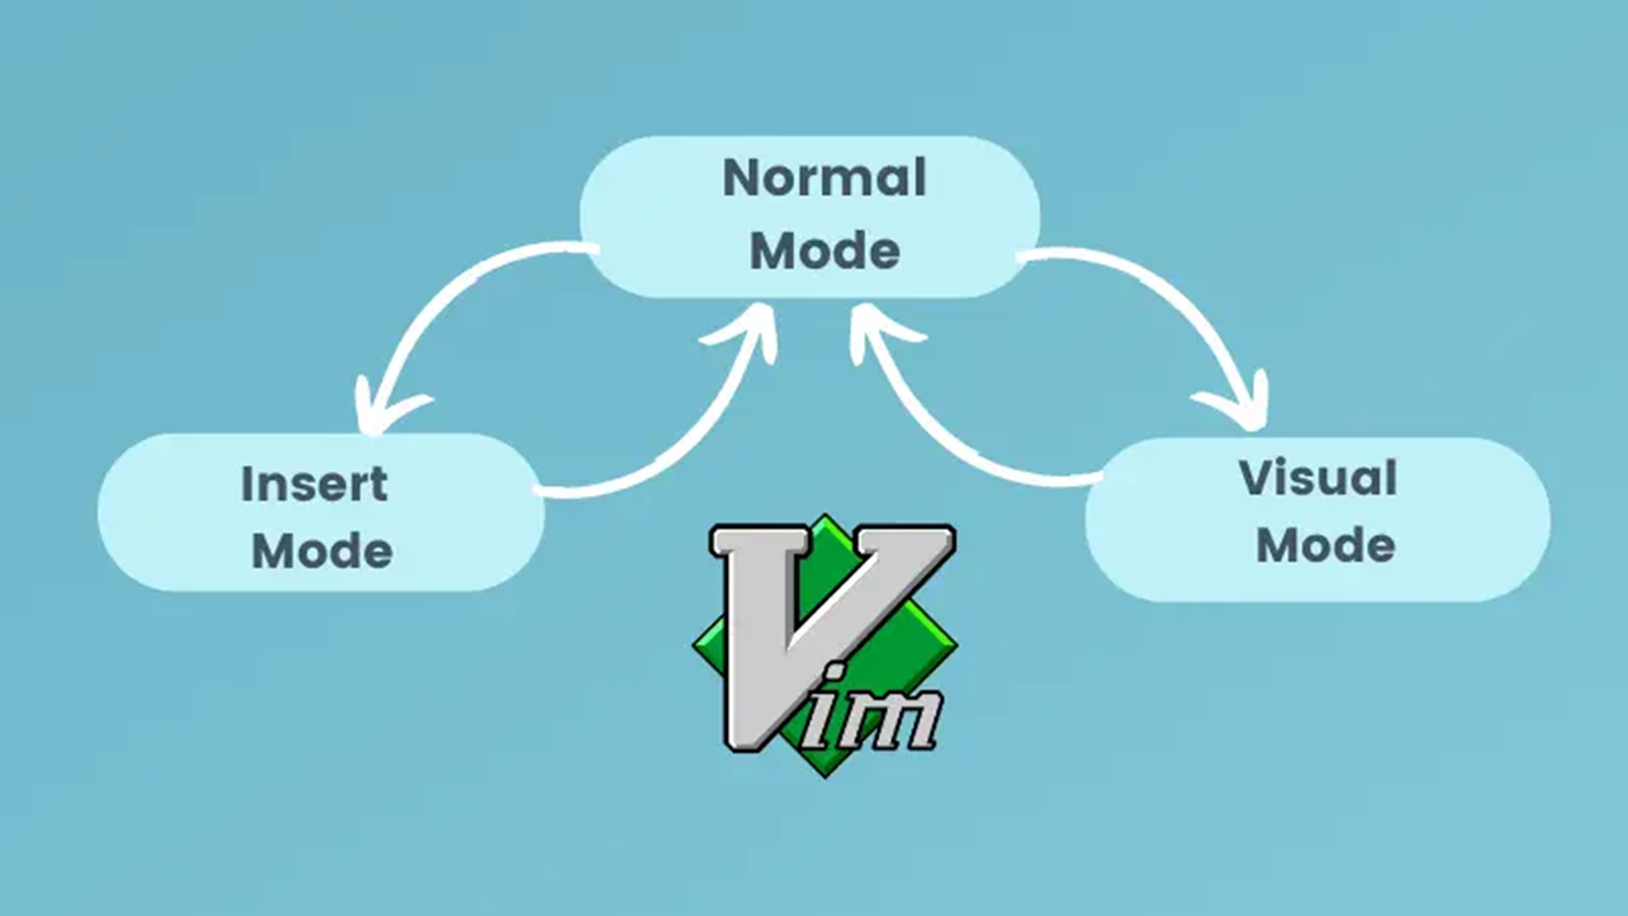

Understanding how Vim works
Vim is a modal text editor, which means you have different mode, and different shortcut for each mode, somewhat like driving a car and changing gears

Slide 11
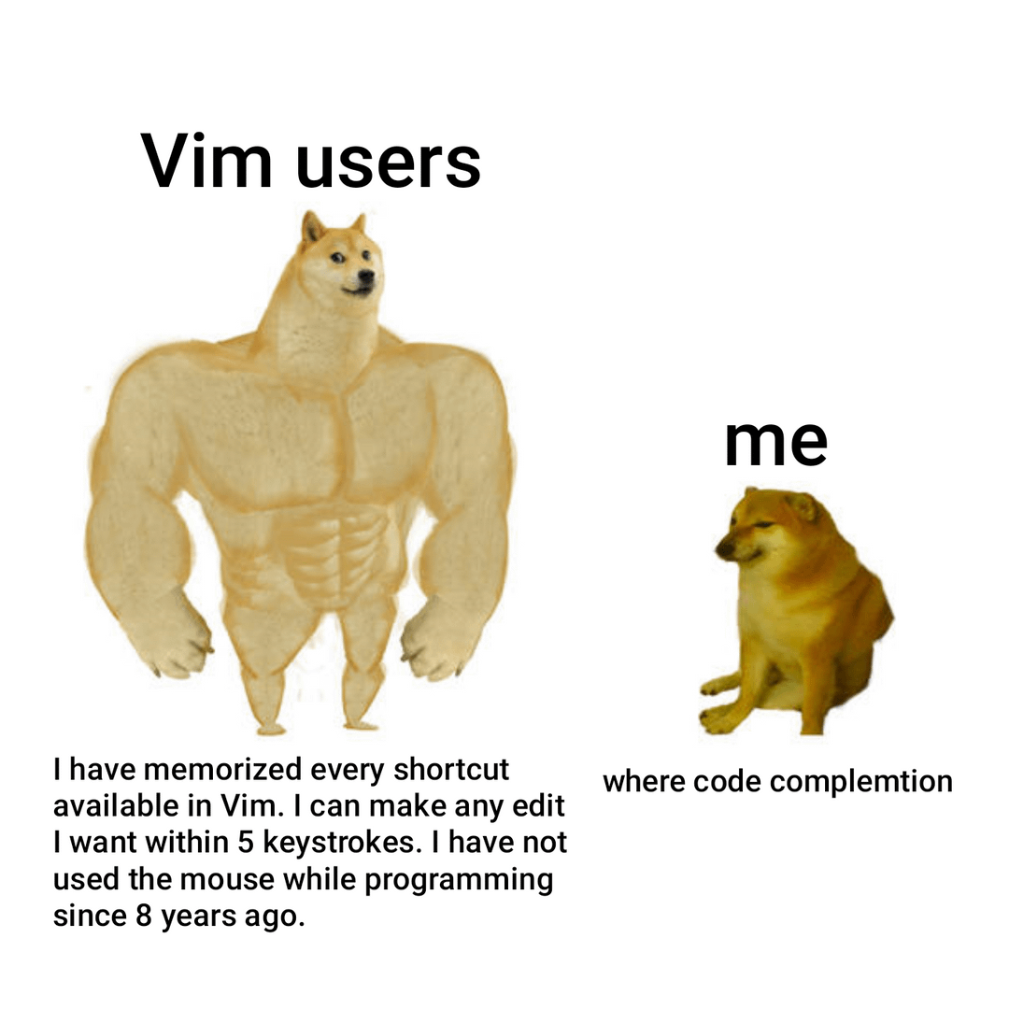
Let’s start using Vim
Enough with the talks, now let’s start trying out Vim…

Slide 12
Getting start with a .vimrc
A vimrc file is a configuration file for the Vim text editor. The name “vimrc” stands for “Vim run commands.” This file contains settings and commands that Vim executes every time it starts.
"--------------------------------------------------
colorscheme elflord
"--------------------------------------------------
" Show line numbers
set number
"--------------------------------------------------
" Enable syntax highlighting
syntax on

Slide 13

When won’t need the mouse but…
"--------------------------------------------------
" Enable mouse support
set mouse=a

Slide 14
Vim for Norminette
Those settings can be useful for norminette
"---------------------------------------------------
set textwidth=80
set colorcolumn=80
" Show tabs as ➡ and spaces as · (Unicode special)
set listchars=tab:➡\ ,space:·
set list " Customize colors for the special characters
highlight SpecialKey ctermfg=DarkGray guifg=DarkGray

Slide 15

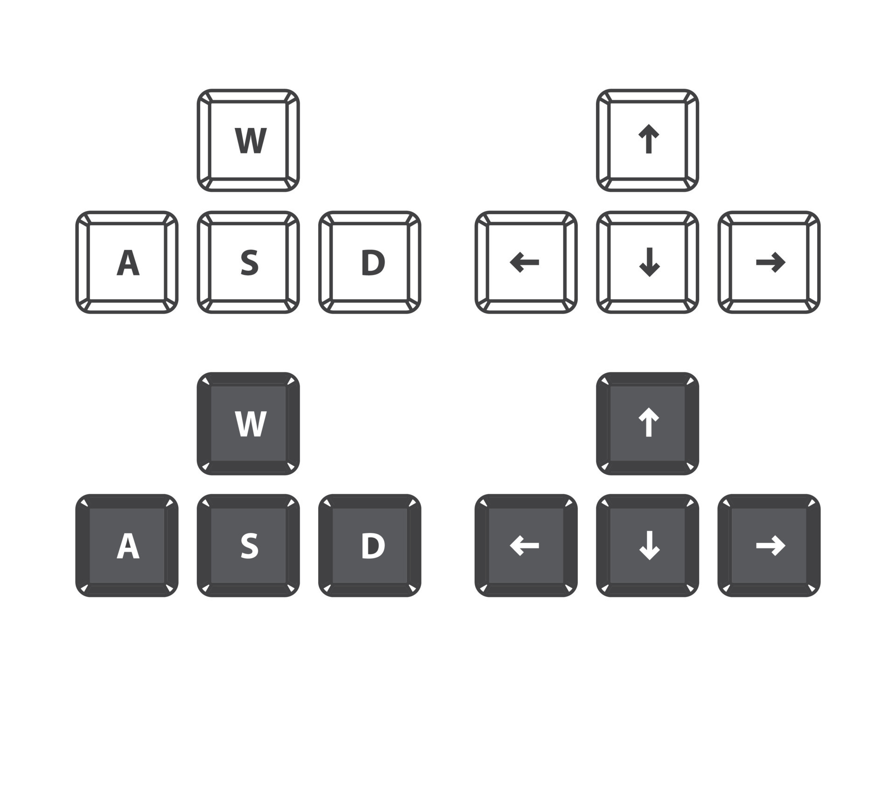
Vim motions
Vim motions are a way to move around in NORMAL mode, if mastered correctly, they can save you a lot of time

Slide 16
Vertical Motions
Starting from k and j, we move on to a faster way of maneuvering vertically with:
} jumps entire paragraphs downwards
{ similarly but upwards
Or you can jump with numbers, there are two way to do so…

Slide 17
Horizontal Motions
You can use the w (word) command to jump to the beginning of the next word…
Use b (back) to jump to the beginning of a word backwards
Use e (end) to jump to the end of a word
Use f{character} (find) to move to the next occurrence of a character in a line. For instance, f" sends you to the next occurrence of a double quote.
If your target is behind the cursor you can use F{character} to find the previous occurrence of a character
0 move to the beginning of the line. $ move to the end of the line

Slide 18
Jump into insert mode
Press “i” to enter insert mode before the cursor.
Press “I” to enter insert mode at the beginning of the current line.
Press “a” to enter insert mode after the cursor.
Press “A” to enter insert mode at the end of the current line.
Press “o” to open a new line below the current line and enter insert mode.
Press “O” to open a new line above the current line and enter insert mode.

Slide 19
Vim Copy and Paste (only the basics)
DELETE dd
YANK yy
We are not going to much into details with registers

Slide 20
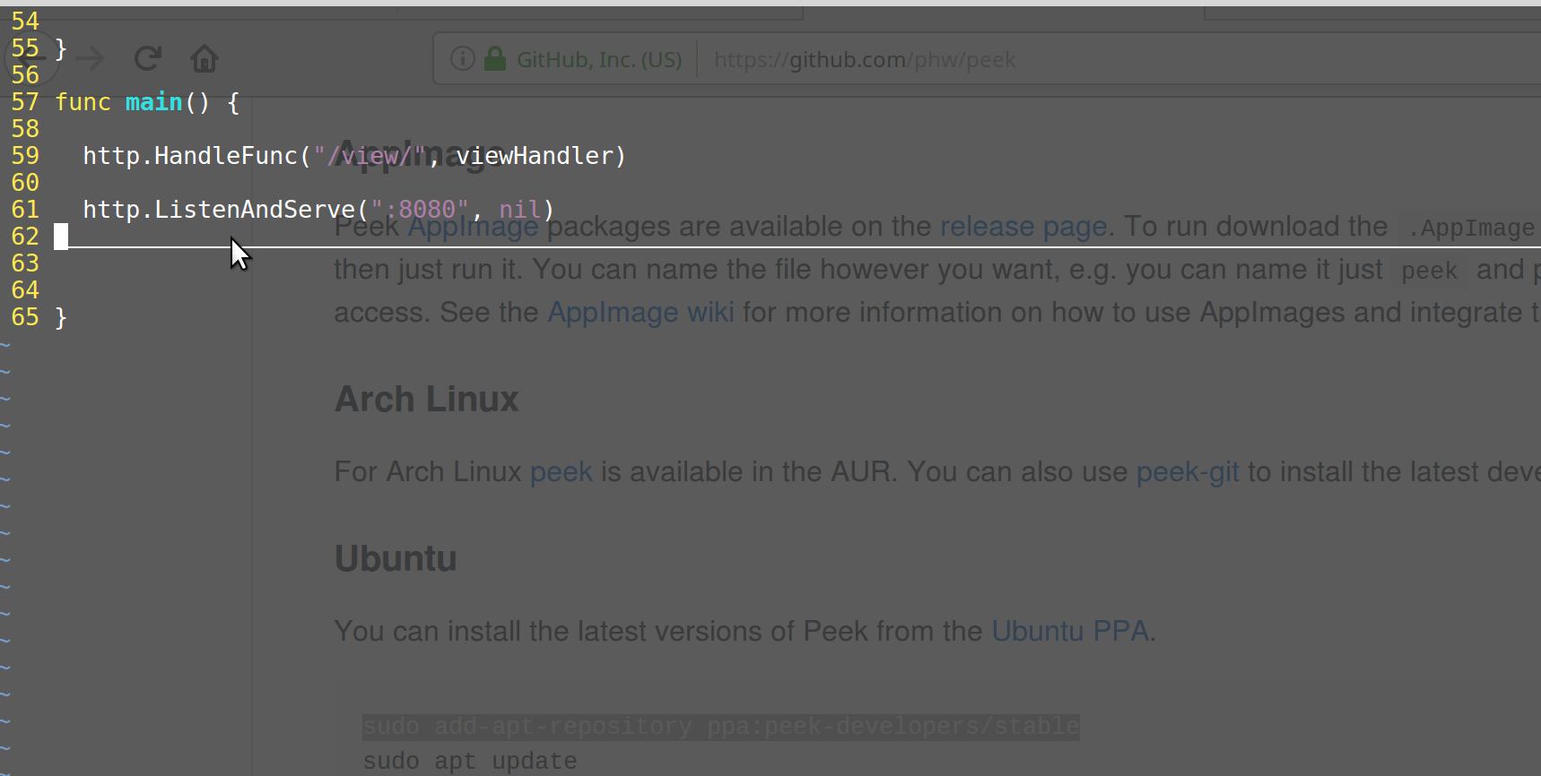
Vim autocomplete cntrl-p

Slide 21
Vim windows management
:Lex
:Rex
"----------------------*** Netrw ***---------------------
" Open Netrw when Vim starts
autocmd VimEnter * :Vexplore
" Set Netrw to open in a vertical split
let g:netrw_winsize = 18
" Hide some unnecessary details in Netrw
let g:netrw_banner = 0
let g:netrw_liststyle = 3
let g:netrw_browse_split = 4
If you press enter, it will open to the next tab,
If you press t , it will open another tab

Slide 22
Looking up text
To move vertically even faster when you have a target in mind, your best option is to search for that target with the /{pattern}

Slide 23
Search and Replace
:%s/old/new/g - replace all old with new throughout file
:%s/old/new/gc - replace all old with new throughout file with confirmations
Sometimes it better to do that in visual mode…

Slide 24

Integration with Makefiles
Vim is well integrated with Make too, I will show you how you can lauch make from inside Vim, and if there are any compilation issues, Vim will automatically bring you to the line where the error occurred.

Slide 25


